Slide 1
Attention Is All You Need
Vaswani, A., Shazeer, N., Parmar, N., Uszkoreit, J., Jones, L., Gomez, A. N., ... & Polosukhin, I. (2017)
Present by Ryan Wang

Slide 2
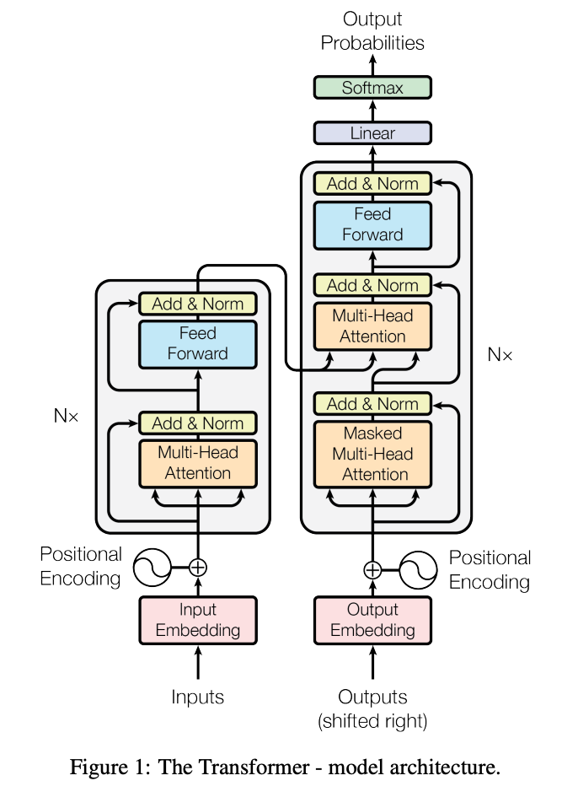
Transformer model
Decoder
Encoder
Sequence to sequence model
Parallel computing
Long-term dependency
Explainable (Attention Matrix)

Slide 3
Illustration of how the model works.
Input
Output
The Transformer Model
Ｇood Morning
早安

Slide 4



The Transformer Model
Input
Output
$$x_{1},…,x_{n}$$
$$z_{1},…,z_{n}$$
$$y_{1},…,y_{m}$$
Ｇood Morning
早安
Encoder
Decoder

Slide 5
The Transformer Model
Input
Output
$$x_{1},…,x_{n}$$
$$z_{1},…,z_{n}$$
$$y_{1},…,y_{m}$$
Good Morning
早安
Encoder
Decoder
N x
N x

Slide 6
In this paper, h = 8 parallel attention layers, or heads.
Here, we set h=2
Good Morning
Output
Feed Forward
N x
Multi-Head Attention
Masked Multi-Head Attention
Feed Forward
N x
Multi-Head Attention (h)
Input
早安

Slide 7
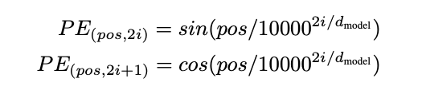


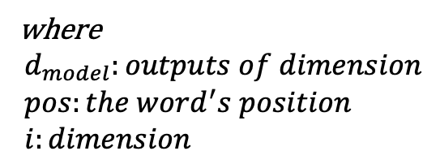
pos/i
0123
pos/i
0123
where $$d_{model}:outputs of dimension \\ pos:the word^{′}s position \\ i:dimension$$
0
1
Positional Encoding
+
+
$$x_{1}$$
$$x_{2}$$
早安
Input Embedding
Input
早安

Slide 8
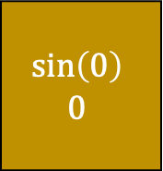
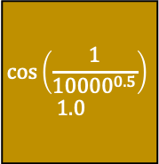

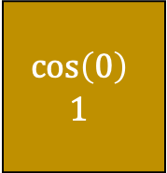
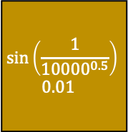

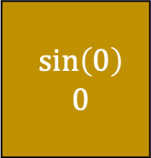
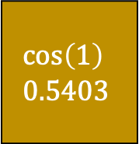
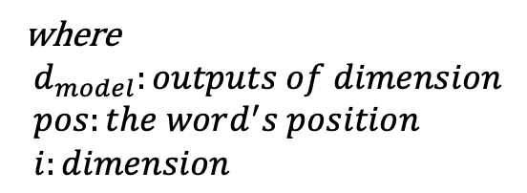
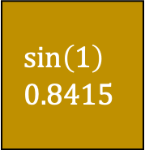
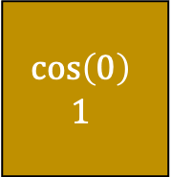
where $$d_{model}:outputs of dimension \\ pos:the word^{′}s position \\ i:dimension$$
pos/i
0011
pos/i
0011
$$\sin\left(0\right) \\ 0$$
$$\cos\left(0\right) \\ 1$$
$$\sin\left(0\right) \\ 0$$
$$\cos\left(0\right) \\ 1$$
$$\sin\left(1\right) \\ 0.8415$$
$$\cos\left(1\right) \\ 0.5403$$
$$\sin\left(\frac{1}{{10000}^{0.5}}\right) \\ 0.01$$
$$\cos\left(\frac{1}{{10000}^{0.5}}\right) \\ 1.0$$
0
1
+
+
$$x_{1}$$
$$x_{2}$$
早安

Slide 9


$$x_{1}^{′}$$
$$x_{2}^{′}$$
Positional Encoding
+
+
$$x_{1}$$
$$x_{2}$$
早安
Input Embedding
Input
早安

Slide 10




Add & Norm
Feed Forward
$$x^{′′}$$
Encoder 1
Add & Norm
Multi-Head Attention
h = 2
Q
K
V
$$x_{1}^{′}$$
$$x^{′}$$
$$x_{2}^{′}$$

Slide 11



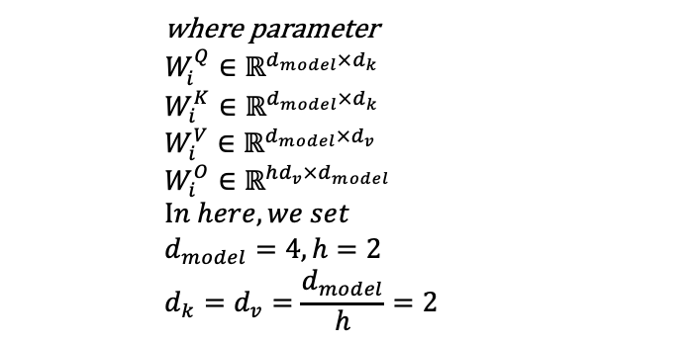






where parameter $$W_{i}^{Q}∈ℝ^{d_{model}×d_{k}}$$
$$W_{i}^{K}∈ℝ^{d_{model}×d_{k}} \\ W_{i}^{V}∈ℝ^{d_{model}×d_{v}} \\ W_{i}^{O}∈ℝ^{{hd}_{v}×d_{model}} \\ In here, we set \\ d_{model}=4, h=2 \\ d_{k}=d_{v}=\frac{d_{model}}{h}=2$$
This weight is our training target.
$$Q$$
$$K$$
$$V$$
$$W_{1}^{Q}$$
$$W_{1}^{K}$$
$$W_{1}^{V}$$
$$x′$$
$$x′$$
$$x′$$
$$x′$$

Slide 12
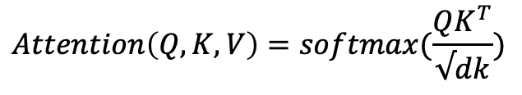
$$Attention\left(Q,K,V\right)=softmax(\frac{QK^{T}}{√dk})$$
$$Q$$
$$K$$
$$V$$
$$W_{1}^{Q}$$
$$W_{1}^{K}$$
$$W_{1}^{V}$$
$$x′$$
$$x′$$
$$x′$$
$$x′$$

Slide 13


$$Attention\left(Q,K,V\right)=softmax(\frac{QK^{T}}{√dk})$$
$$Q×K^{T}$$
$$Q$$
$$K^{T}$$
$$V$$
$$W_{1}^{Q}$$
$$W_{1}^{K}$$
$$W_{1}^{V}$$
$$x′$$
$$x′$$
$$x′$$
$$x′$$

Slide 14





$$Attention\left(Q,K,V\right)=softmax(\frac{QK^{T}}{√dk})$$
$$Q_{1}×K_{1}+Q_{2}×K_{2}=128 (supposely)$$
$$Q_{1}$$
$$K_{1}$$
$$Q_{2}$$
$$Q$$
$$K^{T}$$
$$V$$
$$K_{2}$$
$$W_{1}^{Q}$$
$$W_{1}^{K}$$
$$W_{1}^{V}$$
$$x′$$
$$x′$$
$$x′$$
$$x′$$

Slide 15
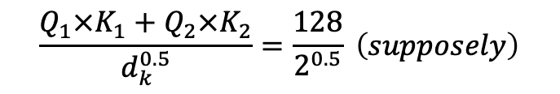
$$Attention\left(Q,K,V\right)=softmax(\frac{QK^{T}}{√dk})$$
$$\frac{Q_{1}×K_{1}+Q_{2}×K_{2}}{d_{k}^{0.5}}=\frac{128}{2^{0.5}} \left(supposely\right)$$
$$Q_{1}$$
$$K_{1}$$
$$Q_{2}$$
$$Q$$
$$K^{T}$$
$$V$$
$$K_{2}$$
$$W_{1}^{Q}$$
$$W_{1}^{K}$$
$$W_{1}^{V}$$
$$x′$$
$$x′$$
$$x′$$
$$x′$$

Slide 16
$$Attention\left(Q,K,V\right)=softmax(\frac{QK^{T}}{√dk})$$
$$softmax\left(\frac{Q_{1}×K_{1}+Q_{2}×K_{2}}{d_{k}^{0.5}}\right)=probability x_{1, 1} (where 0≤x≤1)$$
$$Q_{1}$$
$$K_{1}$$
$$Q_{2}$$
$$Q$$
$$K^{T}$$
$$V$$
$$K_{2}$$
$$W_{1}^{Q}$$
$$W_{1}^{K}$$
$$W_{1}^{V}$$
$$x′$$
$$x′$$
$$x′$$
$$x′$$

Slide 17


$$Attention\left(Q,K,V\right)=softmax(\frac{QK^{T}}{√dk})$$
$$r_{1}$$
$x_{1, 1}$ (can be considered as weights for $V_{1,1})$
X
$$Q_{1}$$
$$K_{1}$$
$$Q_{2}$$
$$Q$$
$$K^{T}$$
$$V$$
$$K_{2}$$
$$W_{1}^{Q}$$
$$W_{1}^{K}$$
$$W_{1}^{V}$$
$$x′$$
$$x′$$
$$x′$$
$$x′$$

Slide 18
Do h times at the same time.

Slide 19






Concatenate all the attention heads (by columns)
$$r_{1}$$
$$r_{2}$$
$$r$$
$$×$$
$$W^{O}$$
$$r^{′}$$
+
$$x′$$
$$r^{′′}$$

Slide 20



$$r^{′′}$$
Layer Normalization
Feature columnß
subtract the mean and divide by the standard deviation.
$$r^{′}′$$
$$x^{′′}$$
Notes:
避免梯度爆炸或梯度消失，針對feature來做是因為每個batch的長度不一，不適合做batch norm.

Slide 21

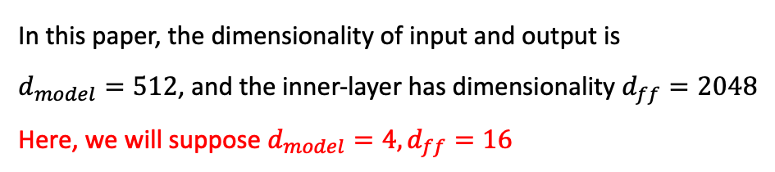
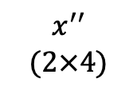



ReLu activation function
$$x^{′′} \\ (2×4)$$
$$FFN\left(x\right)=\max\left(0, xW_{1}+b_{1}\right)W_{2}+b_{2}$$
In this paper, the dimensionality of input and output is $d_{model}=512$, and the inner-layer has dimensionality $d_{ff}=2048$
Here, we will suppose $d_{model}=4, d_{ff}=16$
$$W_{1}(4×16)$$
$$x^{′′}W_{1}$$
+
$$b_{1}$$
( )
ReLu
$$\max\left(0, x^{′′}W_{1}+b_{1}\right)$$

Slide 22



$$W_{2}$$
$$\max\left(0, x^{′′}W_{1}+b_{1}\right)$$
$$\max\left(0,x_{1}^{′′}W_{1}+b_{1}\right)W_{2}$$

Slide 23




$$\max\left(0,x_{1}^{′′}W_{1}+b_{1}\right)W_{2}$$
+
$$b_{2}$$
$${\max\left(0,x_{1}^{′′}W_{1}+b_{1}\right)W_{2}+b}_{2}$$
+
$$x^{′′}$$
Layer Normalization
$$z_{1}$$

Slide 24
Decoder
Encoder
k
v
q
(Matrix o)
[S] Good Morning (3x4)

Slide 25
Let’s see Masked Multi-Head Attention

Slide 26
Masked Multi-Head Attention
Prevent leftward information flow in the decoder
Preserve the auto-regressive property
We can’t see the future!
It’s a lower triangular matrix.
我是文豪
我是文豪
= 0
= -inf

Slide 27
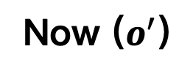
Decoder
Now ($o^{′}$)
k
v
q

Slide 28







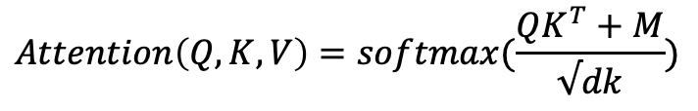






$$Q$$
$$M$$
$$Attention\left(Q,K,V\right)=softmax(\frac{QK^{T}+M}{√dk})$$
$$K^{T}$$
$$r_{1}$$
$$×$$
$$+$$
softmax
()
$$√2$$
X
$$Q$$
$$V$$
$$K^{T}$$
$$W_{1}^{Q}$$
$$W_{1}^{K}$$
$$W_{1}^{V}$$
$$o′$$
$$o′$$
$$o′$$
$$o′$$

Slide 29
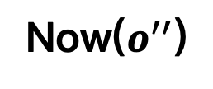
Decoder
Now($o^{′′}$)
k
v
q

Slide 30










$$Q$$
$$r_{1}$$
$$K^{T}$$
$$×$$
softmax
()
$$√2$$
X
$$Q$$
$$V$$
$$K^{T}$$
$$W_{1}^{Q}$$
$$W_{1}^{K}$$
$$W_{1}^{V}$$
$$o^{′′}$$
$$z_{1}$$
$$z_{1}$$
$$z_{1}$$
(Encoder output)
$$o^{′′}$$

Slide 31
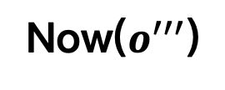
Decoder
Now($o^{′′′}$)
k
v
q

Slide 32



Assuming the dictionary contains 1000 words.
Highest probability
Ground Truth
Good
$$o^{′′′′′}$$
...
Morning
[E]
softmax
()
$$o^{′′′′}$$
...
3x1000
$$ReLu(O^{′′′}W^{L}+b^{L},) where W^{L}\& b^{L}∈ℝ^{d_{model}× dicionaryWords}$$
$$o^{′′′}$$

Slide 33
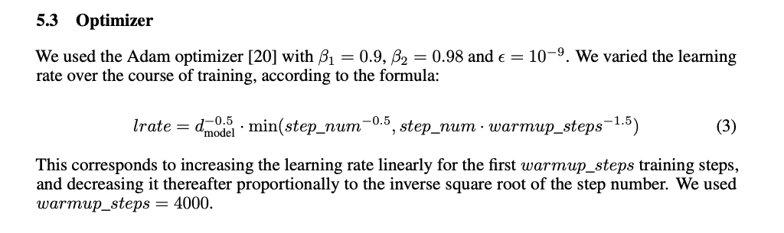
Optimizer & Loss function
Optimizer
Adam optimizer
Warmup skills
Loss function
Cross-Entropy
Notes:
Cross-Entropy & Adam optimizer

Slide 34
Review
Transformer: A Novel Neural Network Architecture for Language Understanding – Google AI Blog (googleblog.com)

Slide 35
Thanks for listening.

